Slide 1
Git perusteet

Slide 2
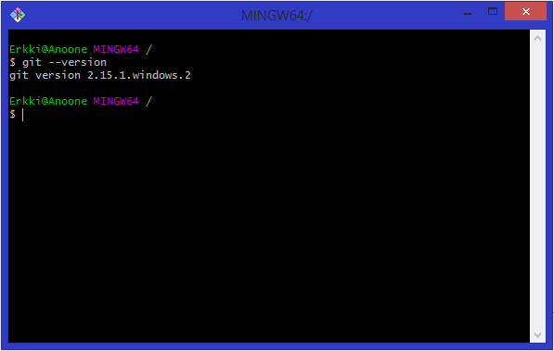
Git --version

Slide 3

Configuration

Slide 4
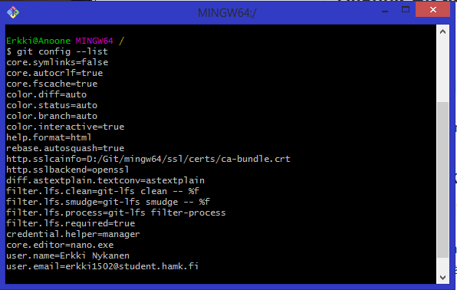
Config list

Slide 5
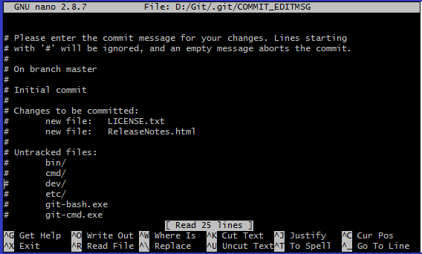
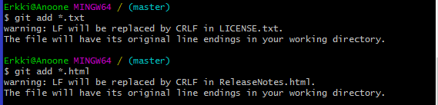

Local repository
Here I am adding all .txt files and all html files to be tracked
Committing said files ->

Slide 6
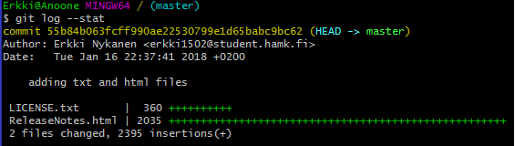
Git log --stat
Command tells who committed and when

Slide 7
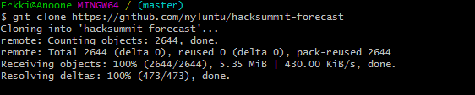
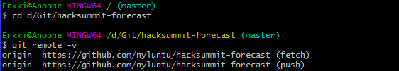
Cloning a repository from url
Changing directory to the cloned repository and running git remote –v command

Slide 8
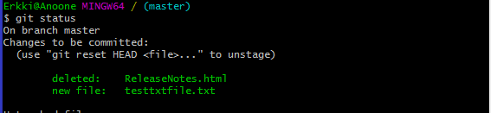
Git status

Slide 9
Git directory committing
Committing every unstaged file and committing them at the same time
git add -A && git commit -m “commit message"

Slide 10
What does git commit do
Git commit stores changes made in the current commit to a new commit with a log message

Slide 11
Untracking files
Global
Add the paths to your files which you would like to ignore to your .gitignore file and commit them. These file entries will also apply to others checking out the repo.
Local
Add the paths to your files which you would like to ignore to your .git/info/exclude file. These file entries will only apply to your local working copy.

Slide 12
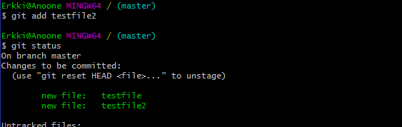
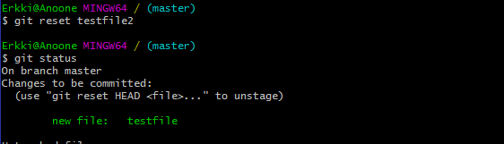
Git reset
Adding a testfile2
Reseting said testfile

Slide 13
Git mv command
Git mv moves a file or directory and I would use it because its easy to use, I cant think of reasons why I wouldn’t use it.

Slide 14
Git rm
Git rm removes a file and I would use it because its easy to use, I cant think of reasons why I wouldn’t use it.

Slide 15
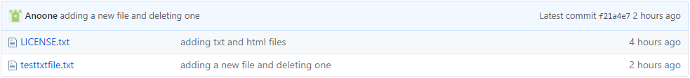

Remote repository push

Slide 16
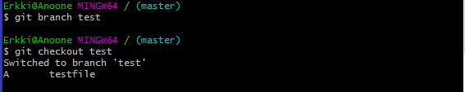

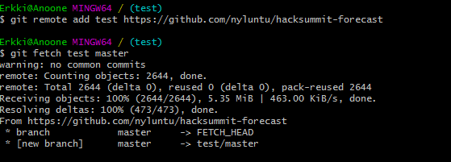
Creating branch and adding another Remote repository

Slide 17
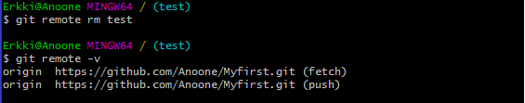
Removing a remote repository

Slide 18

Git fetch
Git fetch can be used to retrieve a certain branch from a remote repository
Simple “git fetch <repository> <branch>”

Slide 19
Git pull
Git pull does the same thing as git fetch but performs a merge at the same time
“git pull <repository> <branch>”

Slide 20
Git push
Git push transfers changes to a remote repository
“git push <repository> master”

Slide 21
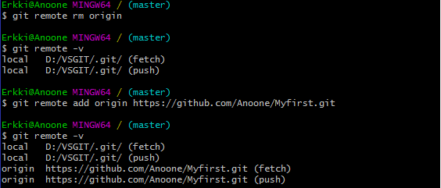
Adding/removing remote repositories
Git remote add <name> <repository url> adds a remote repository
Git remote rm <name> removes a remote repository

